Slide 1


Data Manipulation with Data.Table.
Expanding the open-source ecosystem around data.table in R
Doris Amoakohene Afriyie

Slide 2
What is data.table
Enhanced data.frame, inherits from and extends data.frame
Columnar data structure
Every column must be of the same length but can be of different type
Concise and consistent syntax , in terms of rows, columns, and groups

Slide 3
Data.table Syntax
DT[ i, j, by]
i = on which rows
j= what to do
By = what should be grouped by

Slide 4



Creating a data.table and data.frames
Syntax: The syntax is slightly different between data.table and data.frame.
Efficiency: data.table is known for its efficient and fast performance, especially with large datasets. It uses optimized algorithms and data structures, which can result in faster filtering compared to data.frame for certain operations.
Additional features: data.table provides additional features like the ability to modify data in-place, perform joins, and set keys for faster indexing. These features can be advantageous for complex data manipulation tasks.

Slide 5

Creating a data.table and data.frames
There are three ways of creating a data.table
data.table()
as.data.table()
Fread()
Creating a data.frames
data.frame()
as.data.frames

Slide 6
Creating a data.table using data.table()
Data.frame
x_df <- data.frame(id = 1:2, name = c(“a,” “b”))
x_df
Data.table
library(data.table)
x_dt <- data.table(id = 1:2, name = c(“a, ”b”))
x_dt
Id | name
1 | A
2 | B
Id | name
1 | A
2 | B

Slide 7
Creating a data.table using as.data.table
Making a list a data.table
y <- list(id = 1:2, name = c(“a, ”b”))
y
Data.frame
y.df = as.data.frame(y)
y.df
Data.table
library(data.table)
y.dt <- as.data.table(y)
y.dt

Slide 8
Creating a data.table Using Fread
# Create a CSV file with some sample data
data <- "Name, Age, Salary
John,25,50000
Alice,30,60000
Bob,35,70000“
# Save the data to a CSV file
fwrite(data, "sample_data.csv")
# Read the CSV file into a data.table using fread
dt <- fread("sample_data.csv")
print(dt)

Slide 9
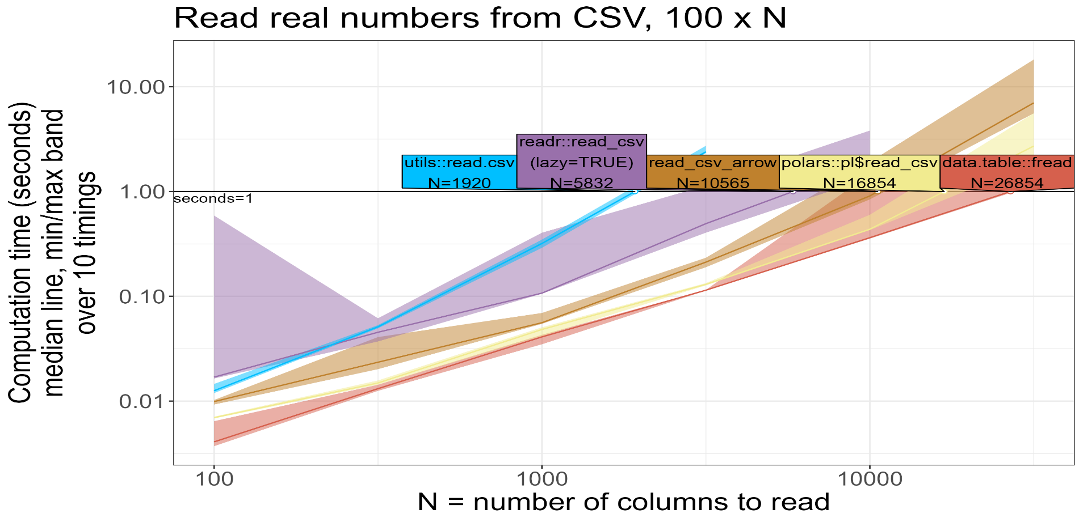
Reading CSV Files

Slide 10
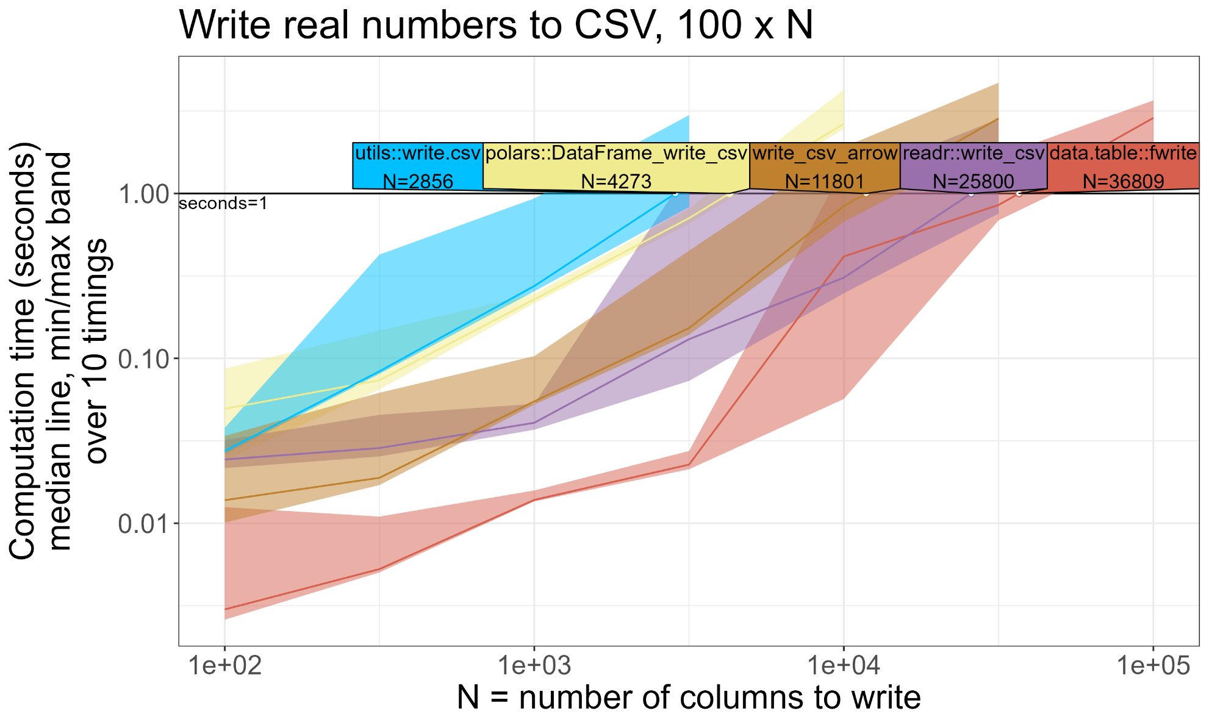
Writing CSV Files

Slide 11
Function used on data.frame can also be used on data.table
Functions used to query data.frames also work on data.tables
nrow
ncol
dim
A data table never automatically converts character columns to factors
x_df <- data.frame(id = 1:2, name = c(“a,” “b”))
x_df
class(x_df$name) = “factor”
x_dt <- data.table(id = 1:2, name = c(“a,” “b”))
x_dt
class(x_dt$name) = “character”

Slide 12
Filtering
Subset by row: You can use the [ operator along with the i argument to filter rows based on a condition
Subset by row and column: You can use the [ operator with both i and j arguments to filter rows and select specific columns
 | Data.table
how to subset the 3rd and 4th rows from a dataset | dataset[3:4] dataset[3:4, ]
Subset everything except first five rows | dataset[-(1:5), ] dataset[-(1:5), ]

Slide 13
Helpers for Filtering
[] (subset operator): The [] operator is used to subset or filter rows in a data.table based on specified conditions.
Example
library(data.table)
# Create a sample data.table
dt <- data.table(x = c(1, 2, 3, 4, 5))
# Filter rows where 'x' is greater than 2
filtered_dt <- dt[x > 2]
# Print the filtered data.table
print(filtered_dt)
x
3
4
5

Slide 14
Helpers for Filtering
%in% (element matching operator): This operator is used to filter rows where a column value matches any element in a specified vector.
Example
library(data.table)
# Create a sample data.table
dt <- data.table(x = c("A", "B", "C", "D"))
# Filter rows where 'x' matches elements in a vector
filtered_dt <- dt[x %in% c("B", "C")]
# Print the filtered data.table
print(filtered_dt)
x
B
C

Slide 15
Helpers for Filtering
DT = data.table(Name=c("Mary","George","Martha"), Salary=c(2,3,4)) DT[Name %like% "^Mar"] DT[Name %ilike% "mar"] DT[Name %flike% "Mar"]
%Like%(pattern matching operator): This function is used to filter rows where a column value matches a specified pattern using wildcard characters.(*,?,.)
Example
library(data.table)
dt <- data.table(x = c("apple", "banana", "orange", "grape"))
# Filter rows where 'x' starts with 'a' and ends with 'e'
filtered_dt <- dt[x %like% "^a.*e$"]
# Print the filtered data.table
print(filtered_dt)
x
Apple

Slide 16
Helpers for Filtering
%between% (range filtering): This function is used to filter rows where a column value falls within a specified range.
Example
library(data.table)
# Create a sample data.table
dt <- data.table(x = c(10, 20, 30, 40))
# Filter rows where 'x' is between 15 and 35 (inclusive)
Filtered_dt<-dt[x %between% c(15,35)]
# Print the filtered data.table
print(filtered_dt)
x
20
30

Slide 17
Helpers for Filtering
%chin% operator(fast membership testing): It checks if elements in a vector are present in another vector. It is particularly useful when you want to check if multiple values in one vector are present in another vector efficiently.
Example
library(data.table)
# Create two vectors
vector1 <- c("apple", "banana", "orange")
vector2 <- c("orange", "grape", "kiwi")
# Check membership using %chin%
membership <- vector1 %chin% vector2
# Print the result
Membership
[1] FALSE FALSE TRUE

Slide 18
Symbols
".N" is used to represent the total number of rows in a data.table.
Example
library(data.table)
# Create a sample data.table
dt <- data.table(x = c("A", "B", "C", "A", "B"))
# Calculate the frequency of each value in the 'x' column
dt[, .N, by = x]
x | N
A | 2
B | 2
C | 1

Slide 19
Symbols
:= (assignment by reference): This operator is used to create or modify columns in a data.table without making a copy of the entire object.
Example
library(data.table)
# Create a sample data.table
dt <- data.table(x = c(1, 2, 3))
# Add a new column 'y' based on 'x'
dt[, y := x * 2]
# Print the modified data.table
print(dt)
x | y
1 | 2
2 | 4
3 | 6

Slide 20
Symbols
.SD (Subset of Data): This special symbol is used to refer to the subset of data for each group in a grouped operation.
Example
library(data.table)
# Create a sample data.table
dt <- data.table(x = c(1, 2, 3), y = c("A", "B", "C"))
# Group by 'y' and calculate the mean of 'x' for each group
dt[, .(mean_x = mean(x)), by = y]
y | Mean_x
A | 1
B | 2
C | 3

Slide 21
Symbols
setkey() (set keys for fast indexing): This function is used to set keys on one or more columns in a data.table, enabling faster indexing and sorting operations
Example
library(data.table)
# Create a sample data.table
dt <- data.table(x = c(3, 1, 2), y = c("Z", "X", "Y"))
# Set 'x' as the key column
setkey(dt, x)
# Sort the data.table by the key column
dt <- dt[]
# Print the sorted data.table
print(dt)
x | y
1 | X
2 | Y
3 | Z

Slide 22
Aggregating
The data.table package provides efficient aggregation functions to summarize data.
You can calculate various summary statistics such as mean, sum, count, and more using functions like sum(), mean(), count(), etc.

Slide 23
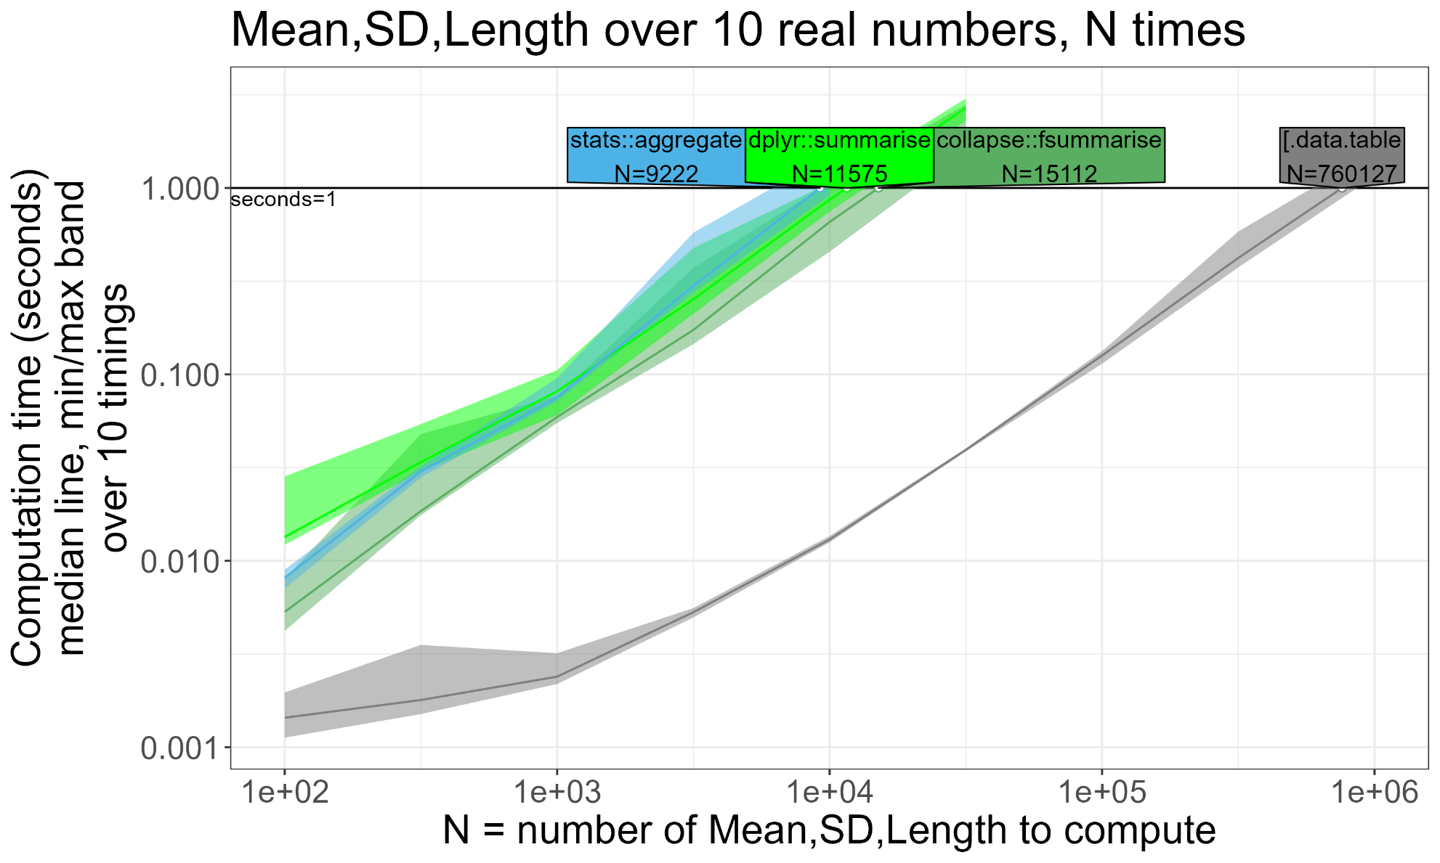
Creating an Expanded Data summary

Slide 24
Sorting
With data.table, you can sort data by one or more columns using the order() function or the setorder() function.
Sorting can be performed in ascending or descending order.
Sorting can also be done while creating an index using the setkey() function.

Slide 25

THANK YOU ???

